Slide 1
Multithreading in Java

Slide 2
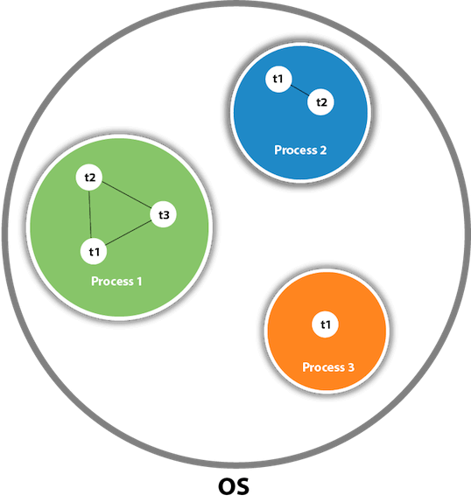
Thread
A thread is a lightweight sub-process.

Slide 3
Cont…
The smallest unit of processing.
Threads are independent

Slide 4
Cont…
If there occurs exception in one thread, it doesn't affect other threads.
It uses a shared memory area.

Slide 5
Multithreading
Multithreading in Java is a process of executing multiple threads simultaneously.
Advantages of Java Multithreading
You can perform many operations together, so it saves time.

Slide 6
Cont…
It doesn't block the user because threads are independent and you can perform multiple operations at the same time.
Threads are independent, so it doesn't affect other threads if an exception occurs in a single thread.

Slide 7
Application of Multi Threading
Games
Animations

Slide 8
Life cycle of a Thread
(Thread States)
There are 5 states in the life cycle of thread .
  New
  Runnable
  Running
  Non-Runnable (Blocked)
  Terminated
Note: The life cycle of the thread in java
is controlled by JVM.

Slide 9
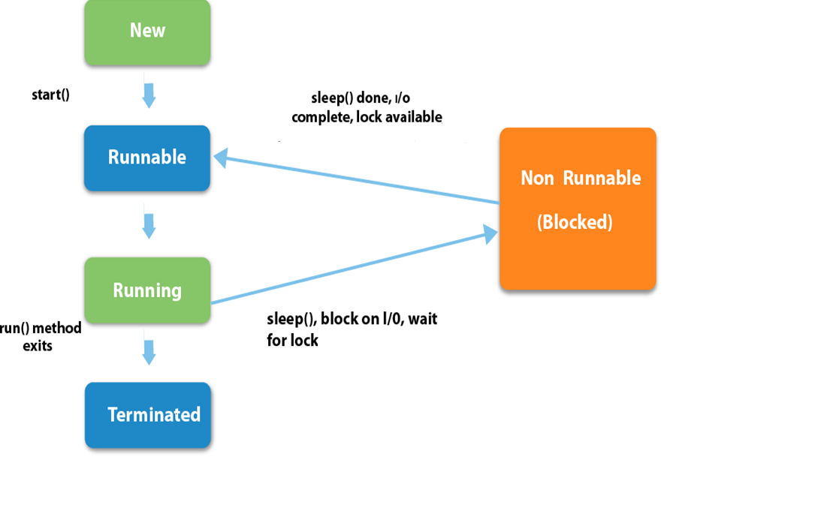
run()
Diagram for Life Cycle of Thread

Slide 10
Cont…
New:
The thread is in new state if you create an instance (object) of Thread class but before the calling of start() method.

Slide 11
Cont…
Runnable:
The thread is in runnable state after calling of start() method, but the thread scheduler has not selected it to be the running thread.

Slide 12
Cont…
Running:
The thread is in running state if the thread scheduler has selected it and in this stage run() method is called.

Slide 13
Cont…
Non-Runnable (Blocked):
This is the state when the thread is still alive, but is currently not eligible to run.
Terminated:
A thread is in terminated or dead state when its run() method exits.

Slide 14
How to create thread
There are two ways to create a thread:
By extending Thread class
By implementing Runnable interface.

Slide 15
1. By extending Thread class
Thread class:
Thread class provide constructors and methods to create and perform operations on a thread.
Thread class extends Object class and implements Runnable interface.

Slide 16
Constructors of Thread class
Thread()
Thread(String name)

Slide 17
Methods of Thread class
public void start(): starts the execution of the thread. JVM calls the run() method of the thread.
public void run(): is used to perform action for a thread. It is declared in Runnable Interface

Slide 18
Cont…
public static void sleep(long milis): It sleeps a thread for the specified amount of time.
public void final setPriority(int newPriority): It set the priority of the thread.
public int getPriority(): It returns the priority of the thread.

Slide 19
Example
class A extends Thread
{
public void run()
  {
  System.out.println(“Thread is running”);
  }
  public static void main(String a[])
  {
  A t1 = new A();
  t1.start();
  }
}
Output: Thread is running

Slide 20
2. By implementing Runnable interface.
Runnable interface:
It contains only run() Method.

Slide 21
Example
class A implements Runnable
{
public void run()
{
System.out.println(“Runnable Interface”);
}
public static void main(String a[])
{
A t1 = new A();
Thread t2 = new Thread(t1);
t2.start();
}
}
Output:
Runnable Interface

Slide 22
Priority of a Thread
Each thread has a priority.
Priorities are represented by a number between 1 and 10.
Default priority of a thread is 5

Slide 23
Cont…
public final void setPriority(int newPriority): It set the priority of the thread which is 1 (minimum) to 10 (maximum).
3 constants defined in Thread class:
  public static int MIN_PRIORITY = 1
  public static int NORM_PRIORITY = 5
  public static int MAX_PRIORITY = 10

Slide 24
Cont…
public int getPriority(): It returns the priority of the thread.

Slide 25
Example
class A extends Thread
{
  public static void main(String a[])
  {
    A t1= new A();
    t1.setPriority(Thread. MAX_PRIORITY);
    System.out.println(t1.getPriority());
  }
}
Output: 10

